Slide 1
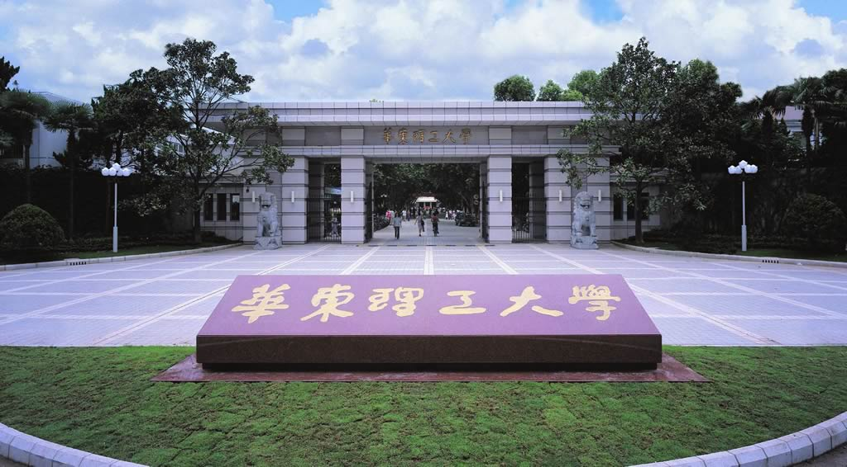
Chapter 4
Protein Identification
Li-Qiang Fan
East China University of Science and Technolog

Slide 2
Protein Identification
Searching and matching proteins’ characteristic data, such as MW, pI, sequence, amino acid composition, PMF etc, from the databases, and identifying the proteins studied

Slide 3


Protein’s ID
Molecule weighe (MW)
Isoelectric point (pI)
Amino acid composition
N-terminal amino acids
C-terminal amino acids
Protein sequencing
Peptide Mass Fingerprinting
……
Notes:
Complete hydrolysis experiments do not allow de novo sequencing

Slide 4


Ways to determine protein’s ID
Traditional chemical methods
Modern Mass spectrometry-based methods

Slide 5
A Traditional chemical methods
Amino acid composition assay
N-terminal sequencing
C-terminal sequencing
Protein sequencing

Slide 6

Amino Acid Composition
Hydrolysis a protein to its amino acid
Calculate the percent/mole ratio of each amino acid in the protein
Search and match the databases
Software: AACompIdent, AACompSim, ASA, FINDER, AAC-PI, PROP-SEARCH etc

Slide 7
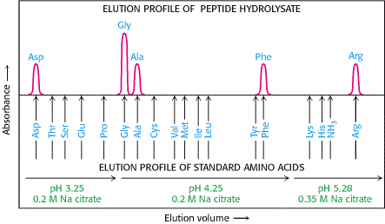
If the unknown protein is
A-G-D-F-R-G
Determination of Amino Acid Composition.
The identity of the amino acid is revealed by its elution volume which is the volume of buffer used to remove the amino acid from the column and the height of the absorption peak that is proportional to the number of times that particular amino acids occurs in the protein.

Slide 8
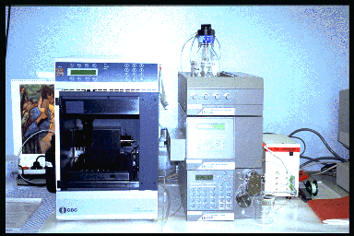
Amino Acid Composition Assay

Slide 9

MultiIdent
Identify proteins with pI, Mw, amino acid compositon, sequence tag and peptide mass fingerprinting data
http://web.expasy.org/multiident/
AACompSim
AACompSim is a tool which allows the comparison of the amino acid composition of a SWISS-PROT entry with all other SWISS-PROT entries so as to find the proteins whose amino acid compositions are closest to that of the selected entry
http://web.expasy.org/aacompsim/
AACompIdent
identify a protein by its amino acid composition.
http://web.expasy.org/aacompident/
PROSEARCH
identify a protein by its amino acid composition.
http://www.embl-heidelberg.de/prs.html

Slide 10
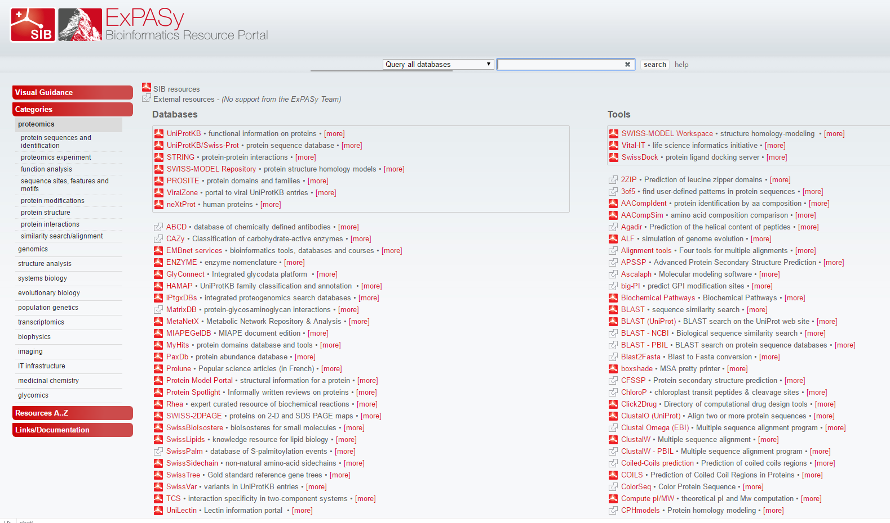
https://www.expasy.org/proteomics

Slide 11
Terminal Micro-sequencing
Theory Bases: proteins have highly specific terminal sequences.
From the N-terminal 4 amino acids, 43-83% proteins can be identified;
From the C-terminal 4 amino acids, 74-97% proteins can be identified
The higher the number of amino acids, the more specific for identify
Software: Tagldent

Slide 12
Tagldent
the generation of a list of proteins close to a given pI and Mw
the identification of proteins by matching a short sequence tag of up to 6 amino acids against proteins in the UniProt Knowledgebase (Swiss-Prot and TrEMBL) databases close to a given pI and Mw
the identification of proteins by their mass, if this mass has been determined by mass spectrometric techniques
http://web.expasy.org/tagident/
Results example
http://binfo.ym.edu.tw/post/internet/tagident_result.htm

Slide 13
N- terminal sequencing
Edman degradation
Labeling the N-terminal amino acid of a protein or peptide with phenyl isothiocyanate (PITC)
Hydrolysis
HPLC assay

Slide 14
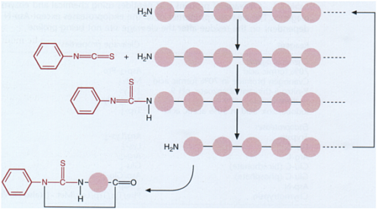
N- terminal --Edman degradation
PITC
label
TFA
hydrolyze
HPLC assay

Slide 15
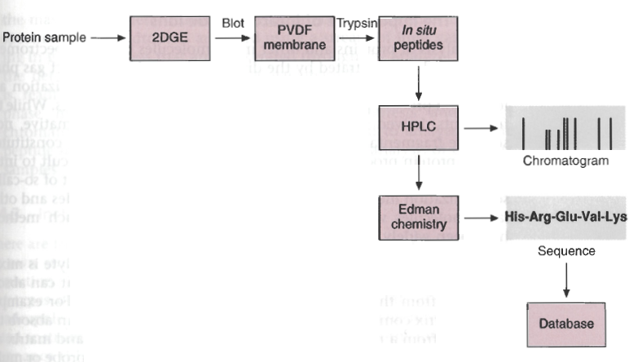
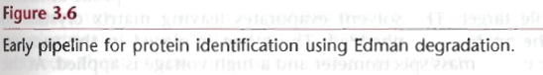
Edman degradation in proteomics

Slide 16

Edman degradation in proteomics
Disadvantages:
laborious & time-consuming (sequencing 10 residues per day);
in some proteins, the α–amino group of the N-terminal amino acid residue is modified, and then fails to react with phenyl isothiocyanate.
Advantages:
Is the most convenient method for determining the N-terminal sequence
Is a very sensitive method (0.5-1 pmol protein)

Slide 17

C- terminal sequencing
exopeptidases + HPLC assay
exopeptidase
+
+
AA1
AA1
exopeptidase
+
AA2
HPLC assay
exopeptidase
+
AA3
Notes:
https://en.wikipedia.org/wiki/Protein_sequencing
The most common method is to add carboxypeptidases to a solution of the protein, take samples at regular intervals, and determine the terminal amino acid by analysing a plot of amino acid concentrations against time. This method will be very useful in the case of polypeptides and protein-blocked N termini.

Slide 18
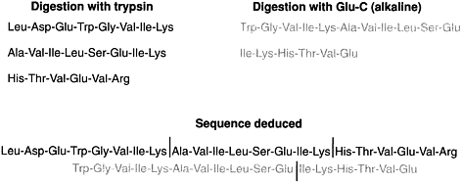

Protein sequencing Overlap digestion and Edman sequencing

Slide 19
B Modern MS-based methods
Mass spectrometry introduction
Component of MS instrument
MS and MS/MS
How to use MS to identify protein

Slide 20
What is mass spectrometry?
MS is an analytical tool that measure the molecular weight of molecules based on the motion of charged particle in an electrical or magnetic field.

Slide 21
Principles of Mass Spectrometry
The Importance of Mass:
The mass of a molecule is a fundamental physical property of a molecule.
Mass can be used to identify the molecule.
Notes:
21

Slide 22
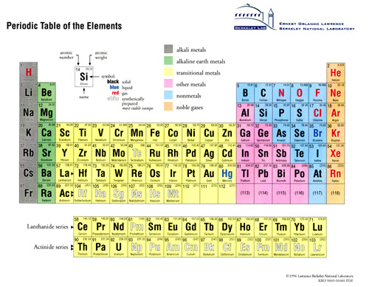
Different elements can be uniquely identified by their mass

Slide 23
Masses of organic molecule
Butorphanol L-dopa Ethanol
N
-CH₂-
OH
COOH
HO
-CH₂CH-NH₂
CH₃CH₂OH
HO
HO
MW = 327.1 MW = 197.2 MW = 46.1

Slide 24
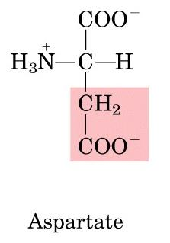
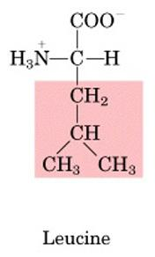
Masses of Amino Acid and protein
H...-HN-CH-CO-NH-CH-CO-NH-CH-CO--OH
R_{i-1}
R_{i}
R_{i+1}
N-terminus
C-terminus
AA residue_{i-1}
AA residue_{i}
AA residue_{i+1}

Slide 25
Principles of Mass Spectrometry
Fragmentation provides Chemical Structure:
If you fragment a molecule in a predictable manner and make measurements on the individual fragments, you can determine the chemical structure of the molecule.
Protein Backbone
H...-HN-CH-CO-NH-CH-CO-NH-CH-CO--OH
R_{i-1}
R_{i}
R_{i+1}
N-terminus
C-terminus
AA residue_{i-1}
AA residue_{i}
AA residue_{i+1}
Notes:
25

Slide 26
B-1 Mass spectrometers
Separate and measures ions based on their mass-to-charge (m/z) ratio.
Operate under high vacuum (keeps ions from bumping into gas molecules)
Key specifications are resolution, mass measurement accuracy, and sensitivity.
Several kinds exist: for bioanalysis, quadrupole, time-of-flight (TOF) and ion traps are most used.

Slide 27
The Hardware for Peptide Mass Spectrometry
Liquid Chromatography
Vacuum Pump
Pump
Ionization Source
Mass Analyzer
Detector
Time of Flight (TOF)
Quadropole
Ion Trap
OrbiTrap
Ion Cyclotron Resonance (ICR)
Different Types:
Electrospray
MALDI
Output:
Spectra
Notes:
27

Slide 28
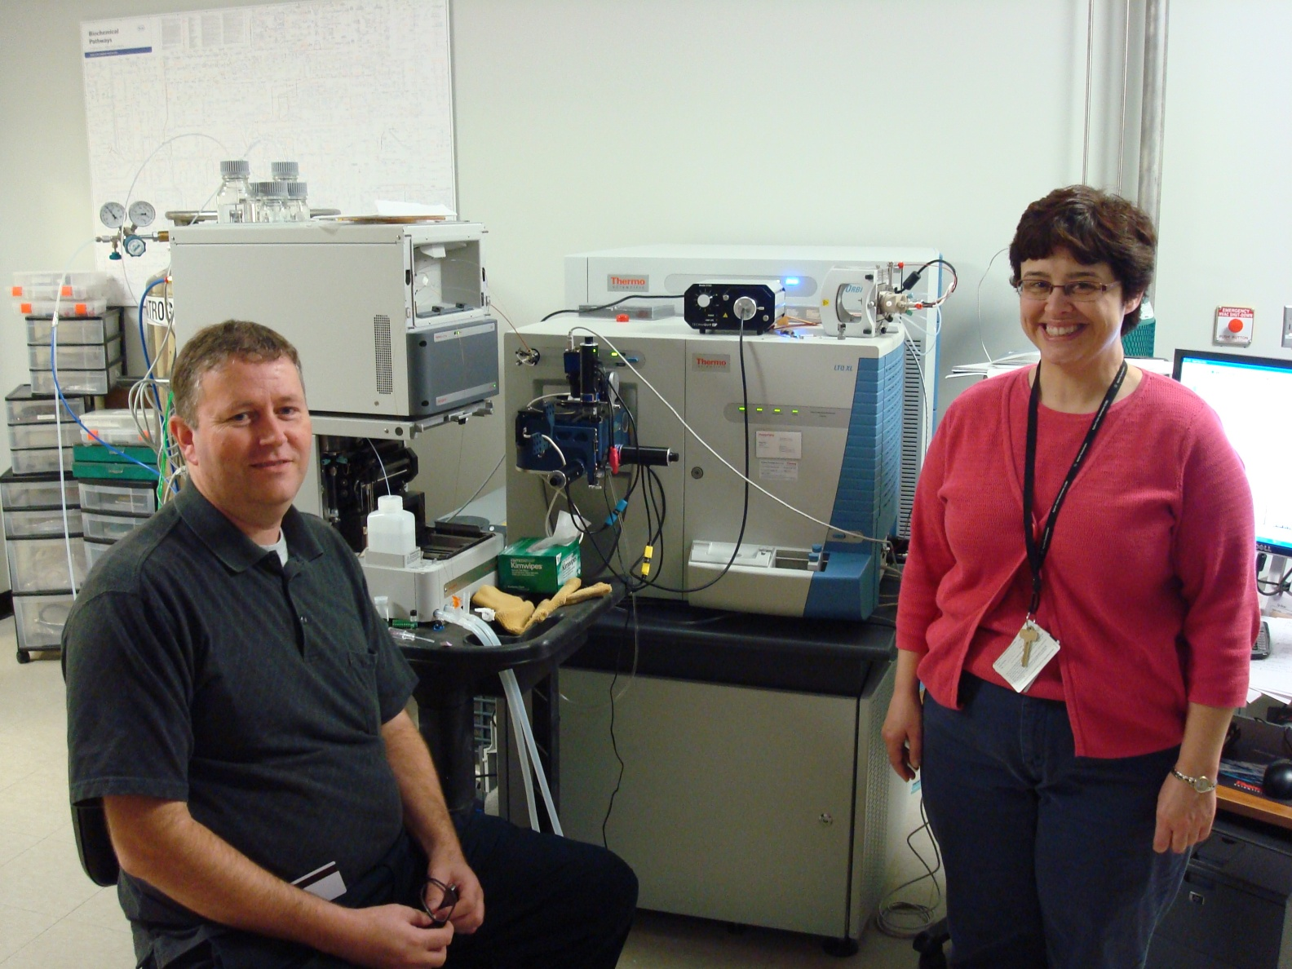
The Hardware for Peptide Mass Spectrometry
Notes:
28

Slide 29
The Hardware for Peptide Mass Spectrometry
Liquid
Chromatography
Ionization Source
Mass Analyzer and Detector
Vacuum Pumps
Notes:
29

Slide 30
Three main parts of Mass Spectrometer
Sample
+
_
Ionization source
Mass Analyzer
Detector
MALDI
Electro-Spray Ionization (ESI)
Time-Of-Flight (TOF)
Quadrapole
Ion-Trap
Electron Multiplier (EM)

Slide 31

How does mass spectrometer work?
Ions formation: the ions are generated by inducing either the loss or the gain of a charge (e.g., deprotonation or protonation).
Two kinds: Molecular ion & fragment ion
Ions separation : once the ions are formed they can be separated according to the m/z
Ions detection
Mass spectrum formation: the resulting mass spectrum may provide the information about MW of a chemical compound or even about its structural information.

Slide 32
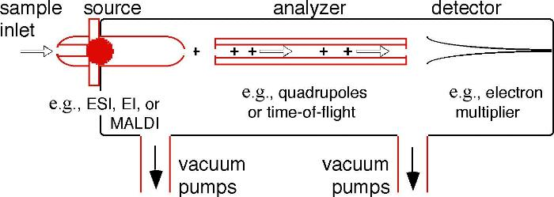
Mass Spectrometry
Load sample onto the MS instrument
Generate ions in the gas phase
Separate ions on the basis of differences in m/z with a mass analyzer
Detect ions, usually by a quantitative method
Process the ion signals to generate mass spectra

Slide 33
Mass Spectrometry

Slide 34
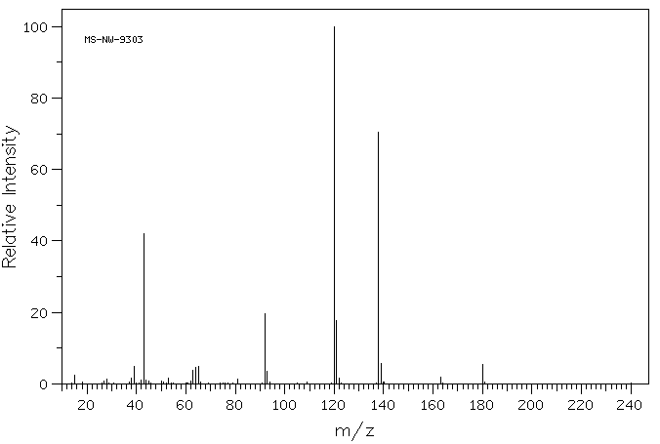
Mass spectrum
An intensity vs. m/z (mass-to-charge ratio) plot representing a chemical analysis
Typical Mass Spectrum
Notes:
Mass spectrum(质谱图)

Slide 35



Typical Mass Spectrum
Characterized by sharp, narrow peaks
X-axis position indicates the m/z ratio of a given ion (for singly charged ions this corresponds to the mass of the ion
Height of peak indicates the relative abundance of a given ion (not reliable for quantitation)
Peak intensity indicates the ion’s ability to desorb or “fly” (some fly better than others)

Slide 36
MS History
JJ Thomson built MS prototype to measure m/z of electron, awarded Nobel Prize in 1906
MS concept first put into practice by Francis Aston, a physicist working in Cambridge England in 1919 and Awarding Nobel Prize in 1922
1920s - Electron impact ionization and magnetic sector mass analyzer introduced
From 1940s, MS was widely used to analyze organic molecules

Slide 37
MS History--continue
1948-52 - Time of Flight (TOF) mass analyzers introduced
1955 - Quadrupole ion filters introduced by W. Paul, who also invents the ion trap in 1983 and wins 1989 Nobel Prize
1968 - Tandem mass spectrometer appears 串联质谱
1980s soft ionization methods was introduced, MS began to use in biomacromolecules.
Now Mass spectrometers are one of the MOST POWERFUL ANALYTIC TOOLS IN CHEMISTRY

Slide 38
质谱的发展历程
研究者 | 时间(年) | 贡献
J. J Thompson | 1906 | 第一台质谱仪
Gohlke and Mclaffertry | 1956 | 气相质谱
Biemann, Seibl等 | 1959 | 肽序列分析
Mclafferty, Jennings等 | 1967 | 串联质谱
Mclafferty | 1973 | 液相质谱
Comisarow and Marshall | 1974 | 傅立叶回旋共振质谱
Barber, Bordoli等 | 1981 | 快原子轰击
Yamashita,Fenn等 | 1984 | 电喷雾离子化用于生物大分子
Tanaka, Karas等 | 1988 | 基质辅助激光解析离子化用于生物大分子

Slide 39
质谱技术常用术语
分子离子：气态分子失去一个电子所得的离子，其荷质比多为离子的质量，用M^{+.}表示
质荷比(m/z)：质谱检测的分子离子的质量与其所带电荷的比值 m/z=(M+nH)/n
质谱图：若形成分子离子还有多余的能量，可导致分子离子内键的断裂，形成许多裂片（碎片）。带正电荷的分子离子及碎片离子按质荷比大小依次通过质谱仪，在其相应的质荷比之处出现峰，得到质谱图，一般采用条图表示。

Slide 40
质谱技术常用术语（2）
分辨率：仪器分开两个质量非常相近的两种离子的能力，即表示仪器在记录质量分别为m与m+m的谱线时，能够辨认出质量差m最小值，通常用R=m/ m表示
10%峰谷法：两峰间的峰谷不大于奇峰高10%时认为两峰已分开
半峰宽法：峰的质量除以峰的半高处测量的同位素峰的宽度，即为该离子在50%相对峰度出的峰宽
Notes:
CO(27.9949) N2(28.0061) R=27.9949/(28.0061-27.9949)=2500

Slide 41
质谱技术常用术语（3）
灵敏度：
绝对灵敏度：仪器可以检测到的最小样品量
相对灵敏度：仪器可以同时检测的大组分与小组分含量之比
分析灵敏度：输入仪器的样品量与仪器输出的信号之比
质量准确度：仪器测得的值与理论值之间的质量差异，即测量误差占被测物的质量的百分比
只有元素组成已知的化合物才能直接确定质量测定的准确度
对于未知样品，通过测量元素组成已知的肽或蛋白质（质量与未知样品相似）的质量，可以大致判断质量准确度
Notes:
CO(27.9949) N2(28.0061) R=27.9949/(28.0061-27.9949)=2500

Slide 42
质谱技术常用术语（4）
单同位素质量：
元素的单同位素质量：该元素的稳定同位素的最轻质量
分析物的单同位素质量：组成该化合物的所有元素的单同位素质量的和
平均质量：所出现元素的化学平均质量的总和。是依据稳定同位素的峰度计算出的值
¹²C 98.92% 12.0000
¹³C 1.08% 13.003355
平均质量：12.011
最高峰质量：同位素簇中峰值最高的同位素的质量，该定义在同位素峰不能分离时使用
Notes:
CO(27.9949) N2(28.0061) R=27.9949/(28.0061-27.9949)=2500

Slide 43

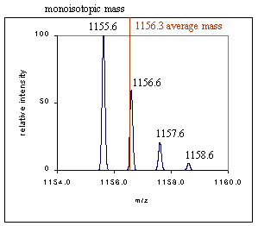
Masses in MS
Monoisotopic mass is the mass determined using the masses of the most abundant isotopes
Average mass is the abundance weighted mass of all isotopic components

Slide 44
质谱技术常用术语（5）
同位素峰：由于蛋白质含有天然同位素，质谱图中会出现M、M+1、M+2等同位素的峰
通常把某元素的同位素占该元素的原子质量分数称为同位素峰度
³⁵Cl, ³⁷Cl; ¹²C, ¹³C; ¹⁴N, ¹⁵N
分子离子峰：有机化合物中失去一个电子获得大一个质子生成的离子，叫分子离子，相应的峰叫分子离子峰
Notes:
CO(27.9949) N2(28.0061) R=27.9949/(28.0061-27.9949)=2500

Slide 45
质谱技术常用术语（6）
碎片离子峰：因分子发生键的断裂只需要十几电子伏特的能量，通过与气体或蒸汽分子碰撞发生分子离子键进一步断裂，产生质量数更小的碎片，称碎片离子峰
碎片离子形成与分子结果密切相关，碎片离子峰可用于化合物结构分析
重排离子峰：分子离子在断裂成碎片离子的过程中，有些碎片离子进一步通过分子内原子或基团的重排而形成重排离子，在质谱上表现为重排离子峰。重排远比简单断裂复杂
亚稳离子峰：质谱中的离子峰不论强弱，大多是尖锐的，但也有少量交宽的峰（可能跨越2-5个质量单位），强度较弱且质荷比不是整数，这种峰叫亚稳离子峰，用m*表示
Notes:
CO(27.9949) N2(28.0061) R=27.9949/(28.0061-27.9949)=2500

Slide 46



B-3 Component of Mass Spectrometry
High Vacuum System
Ion Source
Mass Filter
Data System
Inlet
Detector
Sample Target HPLC GC CE
MALDI ESI Ion Spray API LSIMSS EI CI
TOF Quadruple Ion Trap Magnetic Sector FTMS
Microchannle Electron Multiplier Hybrid
PC’ SunSPAR

Slide 47
Component of Mass Spectrometry
High Vacuum System
Turbo pumps
Diffusion pumps
Rough pumps
Rotary pumps
Ion
Source
Mass
Filter
Data
System
Inlet
Detector
Sample Plate
Target
HPLC
GC
Solids probe
MALDI
ESI
IonSpray
FAB
LSIMS
EI/CI
TOF
Quadrupole
Ion Trap
Mag. Sector
FTMS
Microch plate
Electron Mult.
Hybrid Detec.
PC’s
UNIX
Mac
Ion source --the part of the mass spectrometer that ionizes the material under analysis (the analyte).

Slide 48
Ionization methods
Electron ionization (EI)
Chemical ionization(CI)
Electrospray ionization(ESI)
Mmatrix-assisted laser desorption/ionization (MALDI)
Glow discharge(GD)
Field desorption (FD)
Fast atom bombardment (FAB)
Thermospray desorption/ionization on silicon (DIOS)
Direct Analysis in Real Time (DART)
Atmospheric pressure chemical ionization (APCI)
Spark ionization
thermal ionization (TIMS)

Slide 49
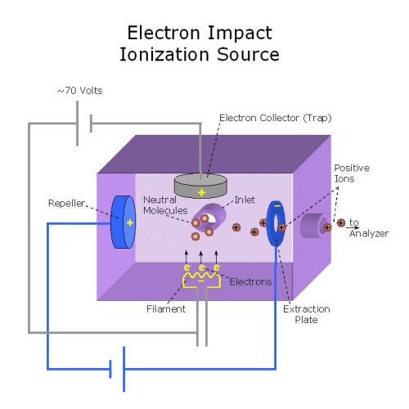
Sample was introduced into instrument
by heating it until it evaporates

Slide 50

Ionization methods
Hard Ionization:
Formation of gas-phase ions accompanied by extensive fragmentation
EI(Electron Impact )
small molecules, 1-1000 Daltons, structure
FAB(Fast Atom Bombardment )
peptides, sugars, up to 6000 Daltons
Soft Ionization
Formation of gas-phase ions without extensive fragmentation
MALDI (matrix-assisted laser desorption/ionization)
peptides, proteins, DNA, up to 500 kD
ESI (electrospray ionization )
peptides, proteins, up to 200,000 Daltons
Notes:
硬电离：属于气相离子源的电离方式，样品一般先蒸发再激发，适于沸点低于500C，对热稳定的样品的离子化，如电子轰击源、化学电离源、场电离源、真空火花源等，适于分子量小于1000的有机物的离子化。该电离方式：离子化能量高、伴有化学键的断裂，产生大量碎片离子，谱图复杂，但可得到分子官能团的信息。不适于蛋白质
软电离：解析离子源的电离方式。包括激光表面解析源（laser desorption,CI）、场解析(field dedorption, FD)、快原子轰击(Fast atom bombardment, FAB)、二次离子质谱、电离子喷雾(electron/ion spray, EI)等

Slide 51

Soft Ionization Methods
337 nm UV laser
Fluid (no salt)
+
_
cyano-hydroxy
cinnamic acid
Gold tip needle
MALDI
ESI

Slide 52

Soft Ionization
Mainly two method:
Electro-spray ionization(ESI): first conceived in 1960’s by Malcolm Dole but put into practice in 1980’s by John Fenn (Yale)
MALDI : first introduced in 1985 by Franz Hillenkamp and Michael Karas (Frankfurt)
Made it possible to analyze large molecules via inexpensive mass analyzers such as quadrupole, ion trap and TOF
Notes:
Protein mass spectrometry refers to the application of mass spectrometry to the study of proteins.
The application of mass spectrometry to study proteins became popularized in the 1980s after the development of MALDI and ESI.

Slide 53
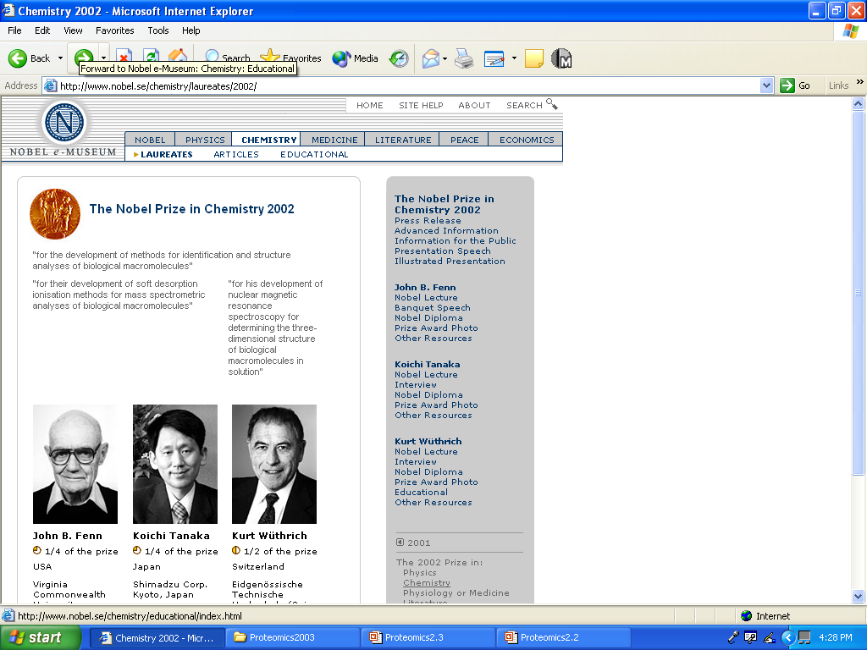

Slide 54
MALDI Ionization
Sample is ionized by bombarding sample with laser light
Sample is mixed with a UV absorbant matrix (sinapinic acid(SA) for proteins, 4-hydroxycin-naminic(CHCA) acid for peptides)
Light wavelength matches that of absorbance maximum of matrix so that the matrix transfers some of its energy to the analyte (leads to ion sputtering)
337 nm UV laser
cyano-hydroxy
cinnamic acid
MALDI
Notes:
常用基质分子：2，5-耳羟基苯甲酸，芥子酸，烟酸，2-氰基-4-羟基肉桂酸等

Slide 55
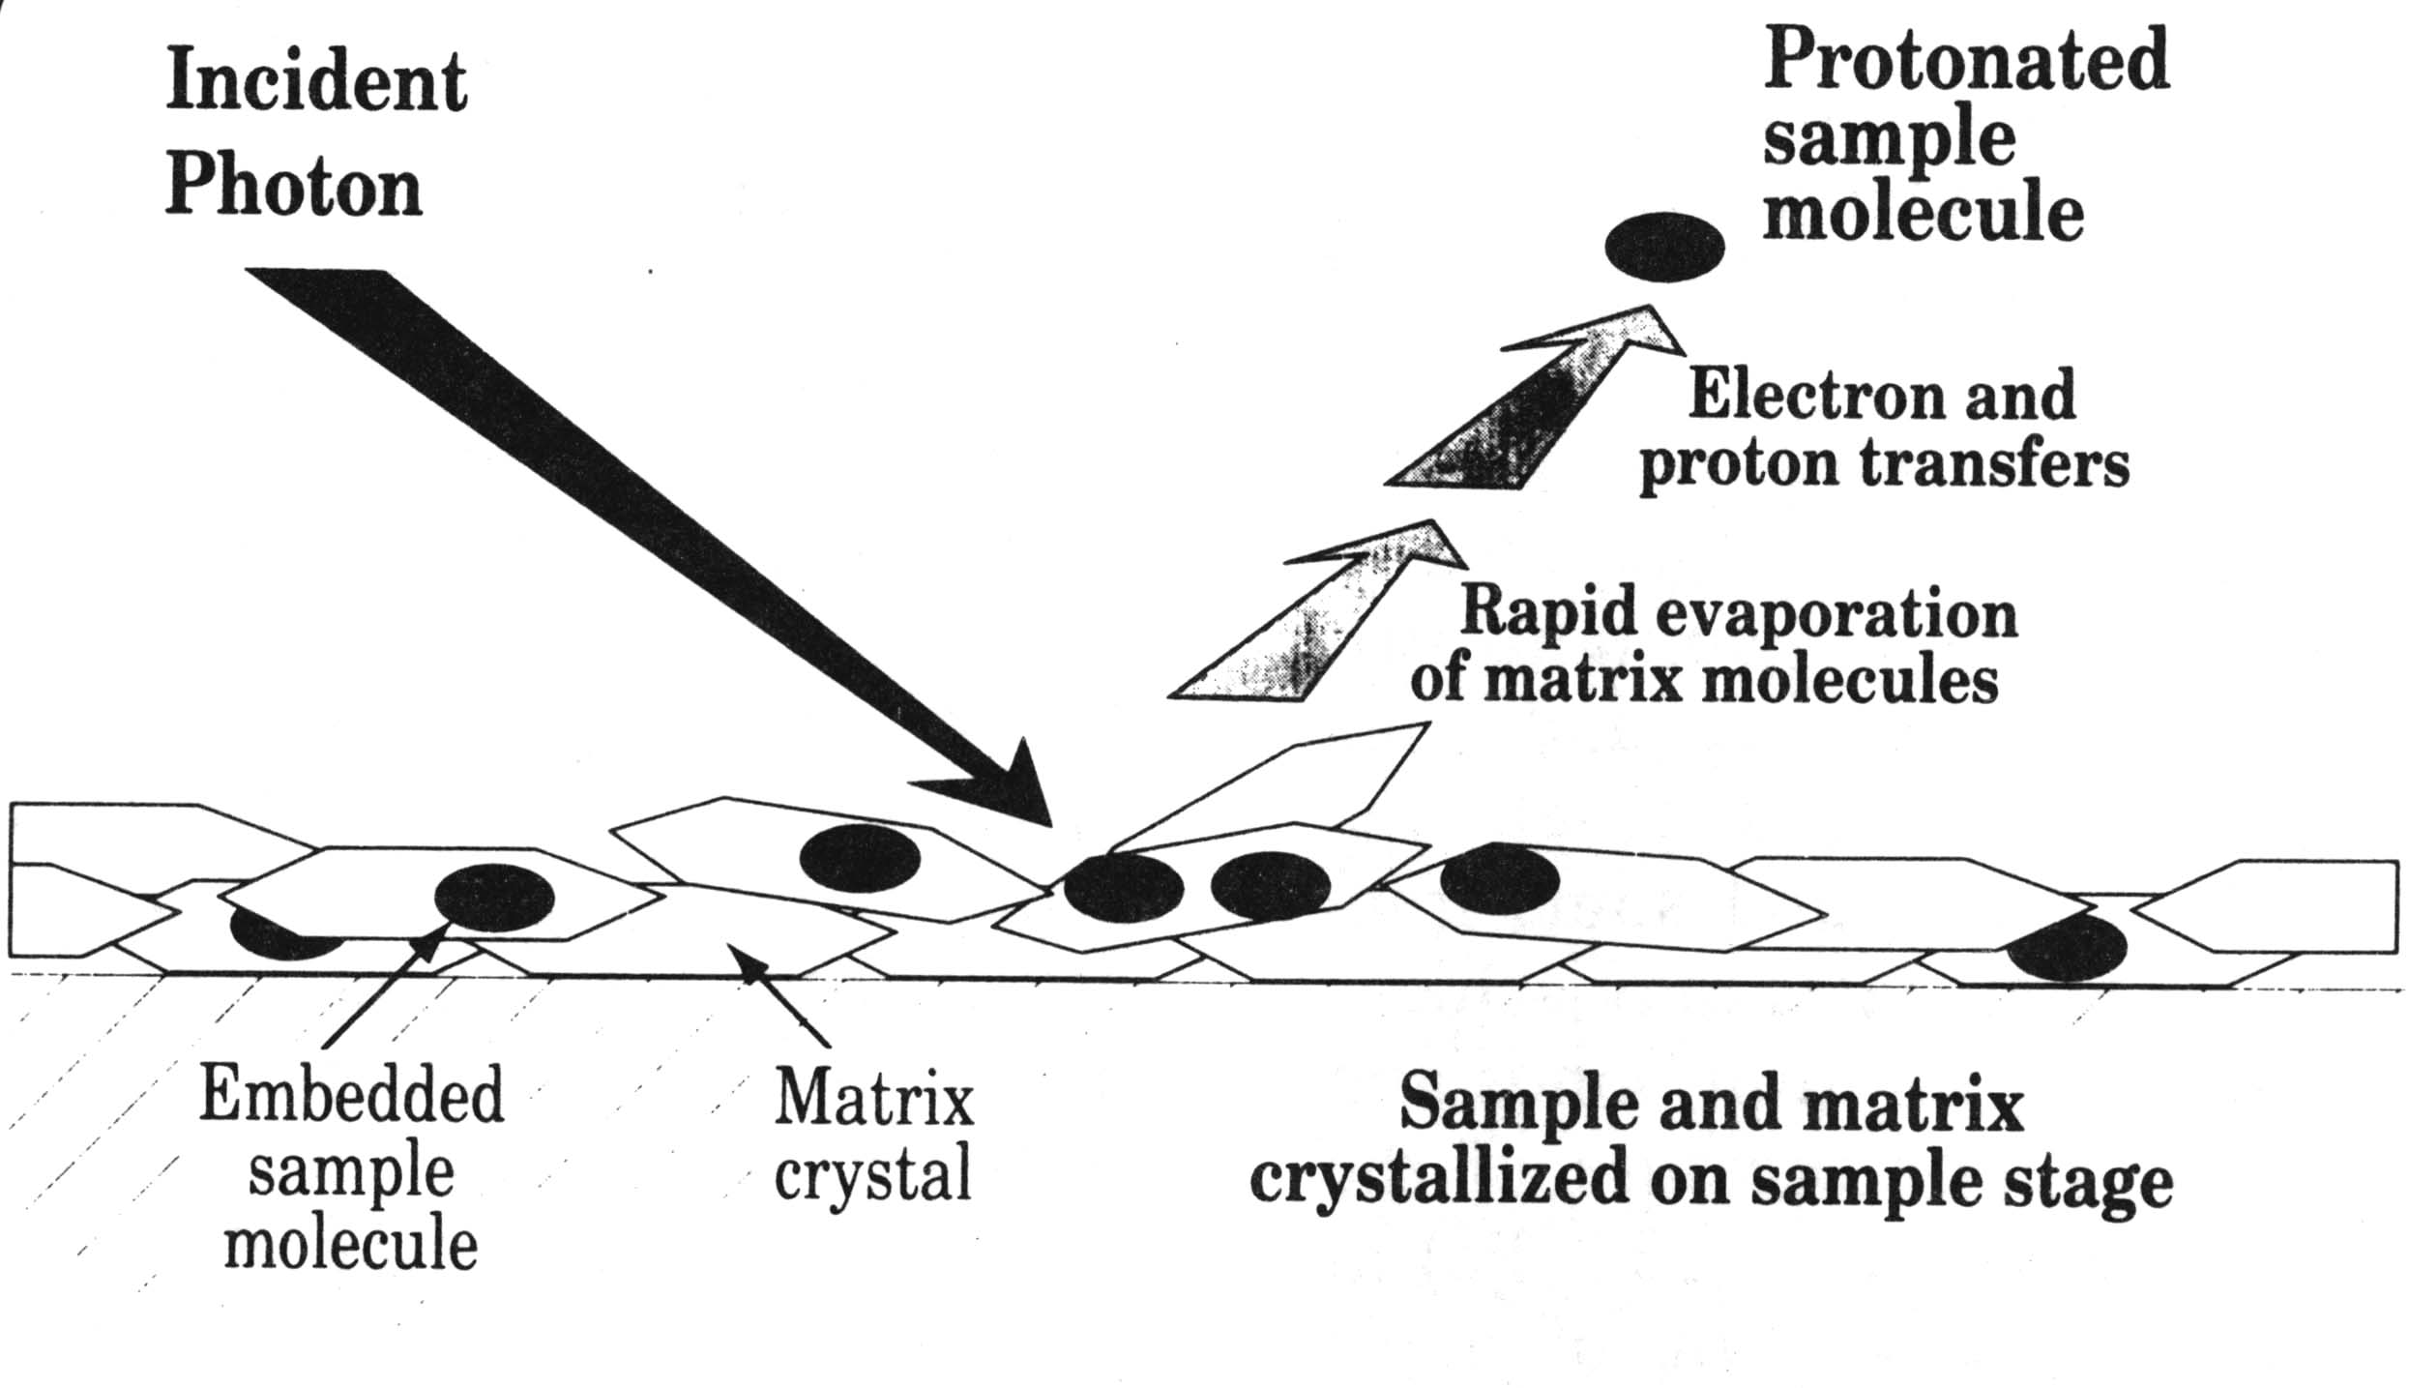
Generalized schematic of proton energy absorption by the matrix in MALDI

Slide 56

MALDI—pulsed generate ions from solid matrix
Generates spectra that have just a singly charged ion
Positive mode generates ions of M + H
Negative mode generates ions of M - H
Generally more robust than ESI (tolerates salts and nonvolatile components)
Easier to use and maintain, capable of higher throughput
Requires 10 mL of 1 pmol/mL sample
Mainly used for peptide/protein mixture analysis

Slide 57
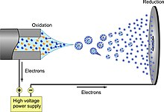
Electrospray Ionization(ESI)
A technique used in mass spectrometry to produce ions using an electrospray in which a high voltage is applied to a liquid to create an aerosol
First reported by Masamichi Yamashita and John Fenn in 1984.
the Nobel Prize in Chemistry to John Bennett Fenn in 2002--ESI for biological macromolecules analysis

Slide 58
Electrospray Ionization(ESI)
A method for continuously generate ion from liquids
Principles:
Sample dissolved in polar, volatile buffer (no salts) and pumped through a stainless steel capillary (70 - 150 mm) at a rate of 10-100 mL/min
Strong voltage (3-4 kV) applied at tip along with flow of nebulizing gas causes the sample to “nebulize” or aerosolize
Aerosol is directed through regions of higher vacuum until droplets evaporate to near atomic size (still carrying charges)
Easily disturb by salts and nonvolatile components
Low sensitivity– “nanospray”
Multiply Charged Ions

Slide 59
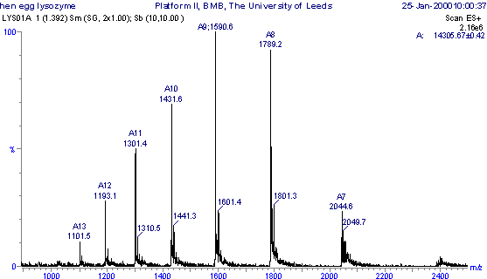
Multiply Charged Ions
ESI spectrum of
HEW Lysozyme
MW = 14,305.14

Slide 60
Peptide Masses From ESI
Each peak is given by:
m/z = (MW + nH+)
n
m/z = mass-to-charge ratio of each peak on spectrum
MW = MW of parent molecule
n = number of charges (integer)
H+ = mass of hydrogen ion (1.008 Da)

Slide 61
Peptide Masses From ESI
Charge (n) is unknown, Key is to determine MW
Choose any two peaks separated by 1 charge
1431.6 = (MW + nH+)
1301.4 = (MW + [n+1]H+)
n
[n+1]
2 equations with 2 unknowns - solve for n first
n = 1300.4/130.2 = 10
Substitute 10 into first equation - solve for MW
MW = 14316 - (10x1.008) = 14305.9
14,305.14

Slide 62
Component of Mass Spectrometry
High Vacuum System
Turbo pumps
Diffusion pumps
Rough pumps
Rotary pumps
Ion
Source
Mass
Filter
Data
System
Inlet
Detector
Sample Plate
Target
HPLC
GC
Solids probe
MALDI
ESI
IonSpray
FAB
LSIMS
EI/CI
TOF
Quadrupole
Ion Trap
Mag. Sector
FTMS
Microch plate
Electron Mult.
Hybrid Detec.
PC’s
UNIX
Mac
Mass analyzer uses an electric and/or magnetic field to affect the path and/or velocity of the charged particles in some way

Slide 63


Mass Analyzers
Magnetic Sector Analyzer (MSA)
High resolution, exact mass, original MA
Quadrupole Analyzer (Q or Q*)
Low (1 amu) resolution, fast, cheap
Time-of-Flight Analyzer (TOF)
No upper m/z limit, high throughput
Ion Trap Mass Analyzer (QSTAR)
Good resolution, all-in-one mass analyzer
Fourier transform ion cyclotron resonance (FT-ICR)
Highest resolution, exact mass, costly

Slide 64
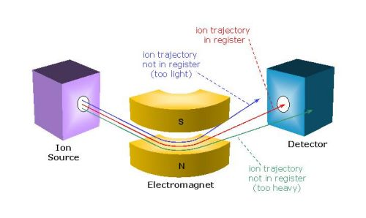
Magnetic Sector Analyzer
Notes:
扇形磁场质谱仪:采用扇形均匀磁场进行聚焦的单聚焦质谱仪称扇形磁场质谱仪。它是静态仪器的一种，其磁场稳定，按偏转半径不同而把不同质荷比的离子区分开。依据扇形磁场角度不分为60 、90 、120 和180 四种。小型仪器的扫描方式采用电扫描法（改变加速电压），而大型仪器多采用磁扫描法（改变磁场强度）。

Slide 65
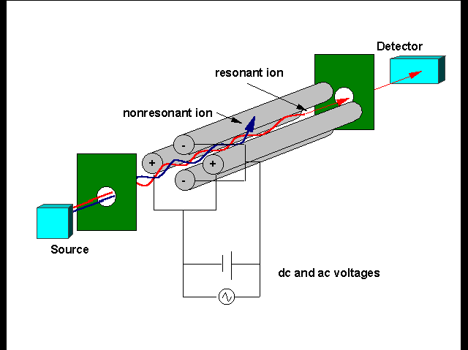
Quadrupole Mass Analyzer
A quadrupole mass filter consists of four parallel metal rods with different charges
Two opposite rods have an applied potential of (U+Vcos(wt)) and the other two rods have a potential of -(U+Vcos(wt))

Slide 66
Quadrupole Mass filter
The applied voltages affect the trajectory of ions traveling down the flight path
For given dc and ac voltages, only ions of a certain mass-to-charge ratio pass through the quadrupole filter and all other ions are thrown out of their original path

Slide 67

Time of flight (TOF)
UV (337 nm)
Microchannel plate detector
Field-free drift zone
Source
Pulse voltage
Analyte/matrix
E_{d} = 0
Length = s
Length = D
Backing plate
(grounded)
Extraction grid
(source voltage -V_{s})
Detector grid -V_{s}
Uses an electric field to accelerate the ions through the same potential, and then measures the time they take to reach the detector
If the particles all have the same charge, the kinetic energies will be identical, and their velocities will depend only on their masses.
Lighter ions will reach the detector first
Notes:
延迟萃取技术，即在激光脉冲发射与导出电场加压之间增加了数百秒至数千秒的延迟时间，被激发的离子不管它们激发的县后，全部到达导出电场后再同时给它们施加一个高压，使它们同时具有相同的能量进入漂移区，进而飞行到达检测器。该技术的使用明显降低了背景，提高了分辨率

Slide 68
Reflector Time of flight vs Time of flight
Extending flight path and flight time to improve quality analysis ability and accuracy

Slide 69
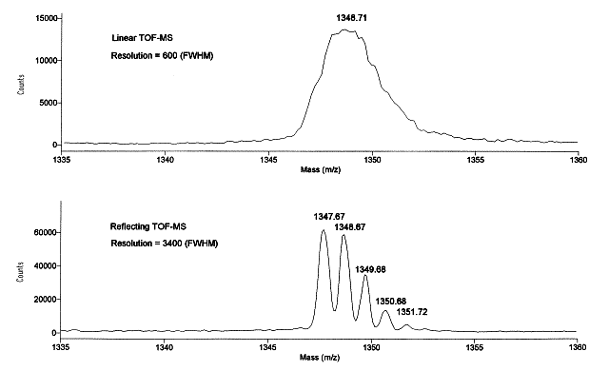
Reflection enhance the resolution

Slide 70
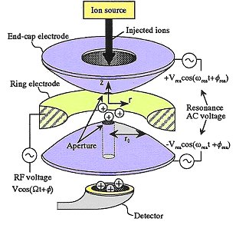
Ion Trap Mass Analyzer
Ion traps use a three-dimensional quadrupole field to trap and mass-analyze ions
Invented by Wolfgang Paul (Nobel Prize1989)
Offer good mass resolving power, and even MS^{n} capability.
Notes:
由一个环形电极和两个端盖电极组成，三个双曲面电极组成了离子捕集室。
在环形电极上加上一个基础射频电压和支流电压，在端盖电极上施加交流补充电压。
由离子源产生的离子通过脉冲离子门进入离子阱。通过调节射频电压和直流电压，使某一质量范围的离子可以稳定的捕获到离子阱中，代理自己累到一定数量后，升高环电极上的射频电压，离子按质荷比从地道搞一次离开离子阱，从而产生任何给定时间上的肽离子谱图。

Slide 71
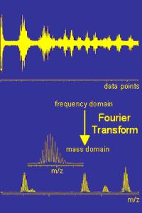
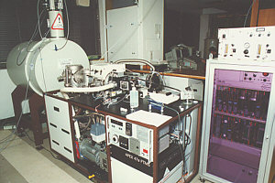
FT-Ion Cyclotron Analzyer
Originally developed in Canada (UBC) by A.G. Marshal in 1974
Measures mass by detecting the produced by ions cyclotroning in the presence of a magnetic field, Instead of measuring the deflection(偏移) of ions

Slide 72
Component of Mass Spectrometry
High Vacuum System
Turbo pumps
Diffusion pumps
Rough pumps
Rotary pumps
Ion
Source
Mass
Filter
Data
System
Inlet
Detector
Sample Plate
Target
HPLC
GC
Solids probe
MALDI
ESI
IonSpray
FAB
LSIMS
EI/CI
TOF
Quadrupole
Ion Trap
Mag. Sector
FTMS
Microch plate
Electron Mult.
Hybrid Detec.
PC’s
UNIX
Mac
The detector records either the charge induced or the current produced when an ion passes by or hits a surface

Slide 73
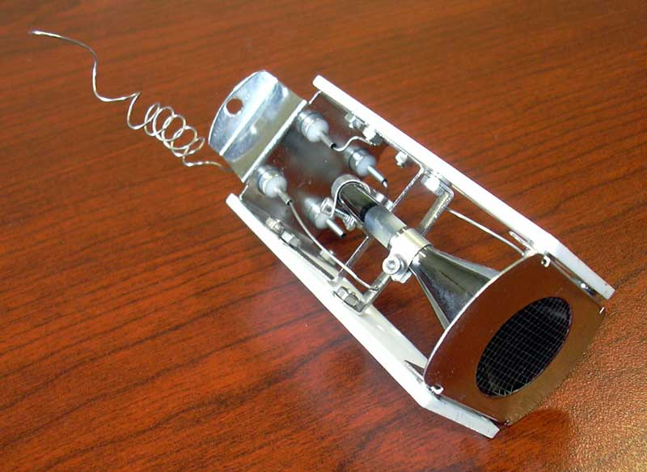
MS Detectors
Early detectors---photographic film
Today’s detectors ---ion channel and electron multipliers--produce electronic signals via 2º electronic emission when struck by an ion
Timing mechanisms integrate these signals with scanning voltages to allow the instrument to report which m/z has struck the detector
Need constant and regular calibration
Notes:
产生放大电流可以作为时间的函数用来测定离子强度（丰度）和m/z.通常以m/z为横坐标，离子相对丰度为纵坐标的形式表示。

Slide 74
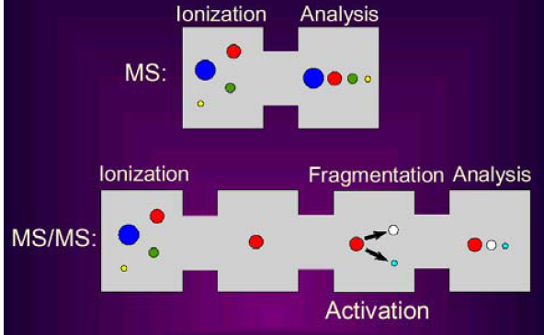
B-4 MS and Tandem MS

Slide 75
Mass Spectromet
Usually Named by Ion source & Analyzer Type

Slide 76
Different Types of MS (I)
MALDI-TOF:
Ion source: MALDI
Analyzer Type: TOF
Sample status: solid phase
PROs: (1) easy
(2) fast
(3) high-through
(4) sensitive.
CONs: (1) only fingerprint of protein, no sequence information
(2) results is highly dependent on sample quality.

Slide 77
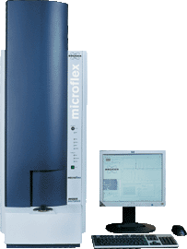
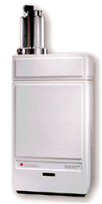
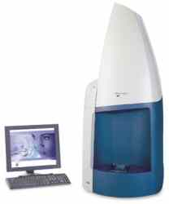
Commercial available MALDI-Tof
Microflex ™, Bruker
Voyager DE-PRO™, ABI
MALDI micro™, Micromass

Slide 78
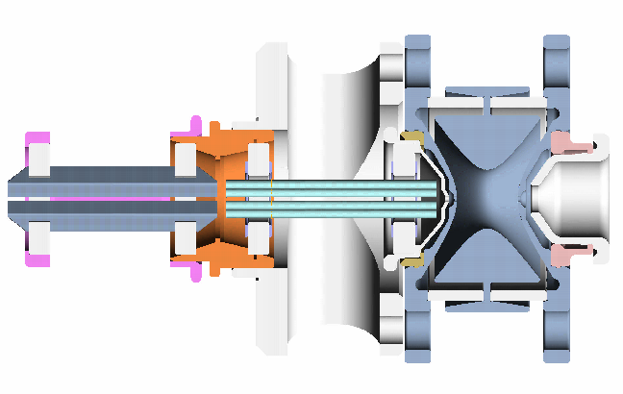
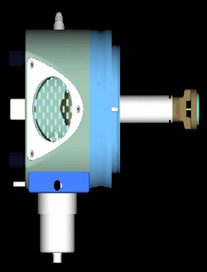
Different Types of MS (II)
ESI-Q:
Ion source: ESI
Analyzer Type:
Quadrupole analyzer
Sample status: liquid phase.
ESI-Ion-trap:
Ion source: ESI
Analyzer Type:
Ion-trap analyzer
Sample status: liquid phase.

Slide 79
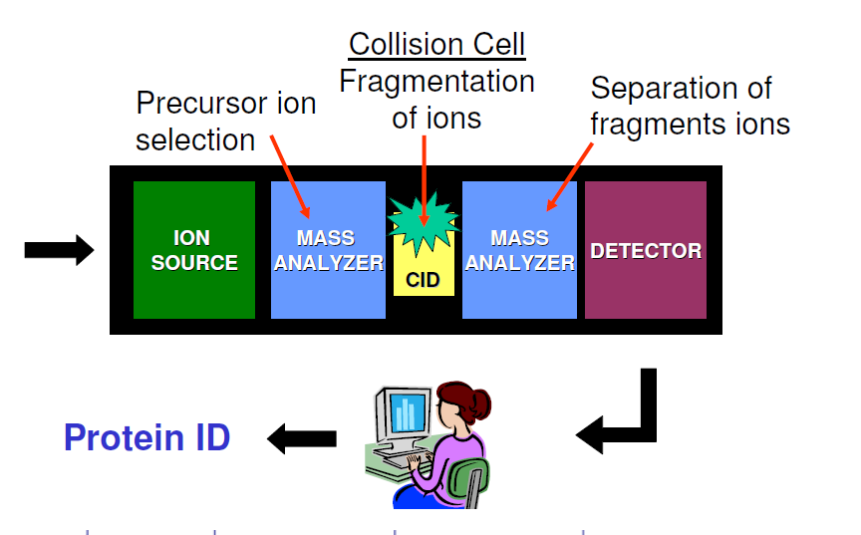

Tandem Mass Spectrometry
Usually use more than one mass analyzer together
Purpose is to fragment ions from parent ion to provide structural information about a molecule
Also allows separation and identification of compounds in complex mixtures
Collision cell is where selected ions are sent for further fragmentation

Slide 80
Tandem MS instruments
Multiple stages of mass analysis separation can be accomplished with individual mass spectrometer elements separated in space or using a single mass spectrometer with the MS steps separated in time

Slide 81
Tandem mass spectrometry in space
the separation elements are physically separated and distinct, although there is a physical connection between the elements to maintain high vacuum.
These elements can be sectors, transmission quadrupole, or time-of-flight
Tandem mass spectrometry in time
the separation is accomplished with ions trapped in the same place, with multiple separation steps taking place over time.
A quadrupole ion trap or FTMS instrument can be used for such an analysis.
Trapping instruments can perform multiple steps of analysis, referred as MSn. N(the number of separation steps)

Slide 82
Tandem Mass Spectrometer
Quadrupole-quadrupole (QQ)
Magnetic sector-quadrupole
Quadrupole-time-of-flight (Q-TOF)
Time-of-flight-time-of-flight (TOF-TOF)
Triple Quadrupole
Ion-trap
Notes:
空间串联：两个质量分析其中间安置一个碰撞室，用第一个质量分析器作为分离手段，选出所要研究的离子，第二个分析器分析碰撞后的子离子
时间串联：仅有一个质量分析器，质谱分析的每一个阶段都在同一区域内发生，但通过”过程“时间顺序而分为不同阶段，如离子阱，傅利叶变换离子回旋质谱仪

Slide 83
Triple Quadrupole Mass Spectrometer
CID: Collision Induced Dissociation
for acquiring Molecular weight and Structural information

Slide 84
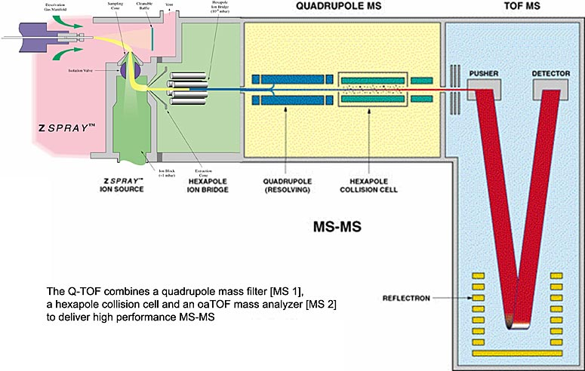
Q-TOF Mass Spectrometer
Collision Cell

Slide 85
ESI-QTOF
Electrospray ionization source + quadrupole mass filter + time-of-flight mass analyzer
MALDI-QTOF
Matrix-assisted laser desorption ionization + quadrupole + time-of-flight mass analyzer

Slide 86
B-5 Use MS to identify protein
Peptide mass fingerprinting (PMF)
Peptide tags
de novo protein sequencing

Slide 87
B-5-1 Peptide mass fingerprinting(PMF)
Also known as protein fingerprinting
Is an analytical technique for protein identification that was developed in 1993 by several groups independently
Is a method that combines MS with protease digestion
The unknown protein of interest is first cleaved into smaller peptides by proteases or chemical agents
The absolute masses of produced smaller peptides are accurately measured with a mass spectrometer
The observed masses are compared with theoretical “ in silico” digests of either a database containing known protein sequences or even the genome
Statistically evaluate and rank the matches or hits

Slide 88
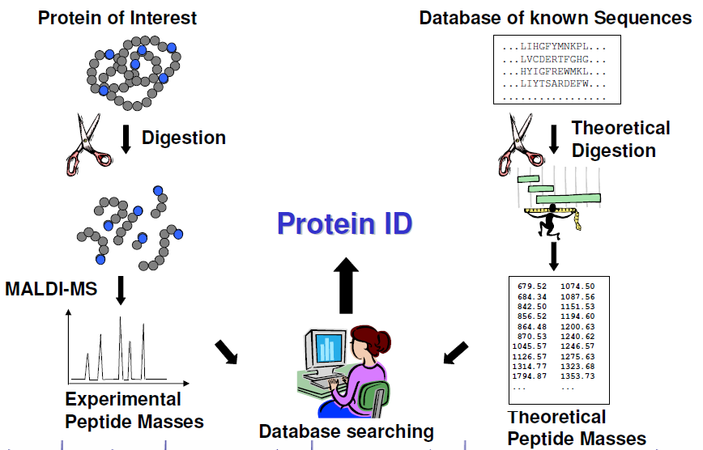
Peptide Mass Fingerprinting (PMF)

Slide 89
Peptide Mass Fingerprinting(PMF)
Spectrum of fragments generated
Spot removed from gel
Fragmented using trypsin
Library
MATCH
Database of sequences
(i.e. SwissProt)
Artificial spectra built
Artificially trypsinated

Slide 90
Enzymes for PMF
Name | Cleave | Don’t Cleave | N- or C- terminal
Trypsin | KR | P | C- terminal
Arg-C | R | P | C- terminal
Asp-N | BD |  | N- terminal
Chymotrypsin | FYWLIVM | P | C- terminal
CNBr | M |  | C- terminal
Formic acid | D |  | C- terminal
Lys-C | K | P | C- terminal
Trypsin: a protease that cleaves after basic residues (R or K)
High specificity
Peptides in a mass range compatible with MALDI
Small enzyme

Slide 91
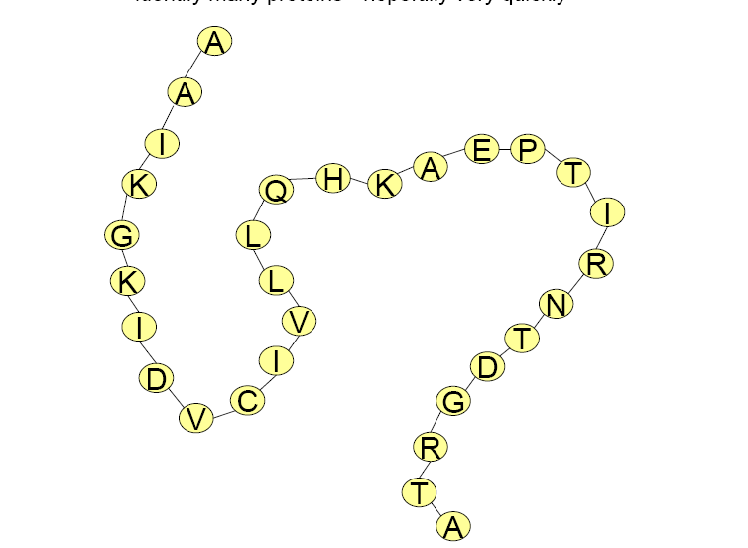
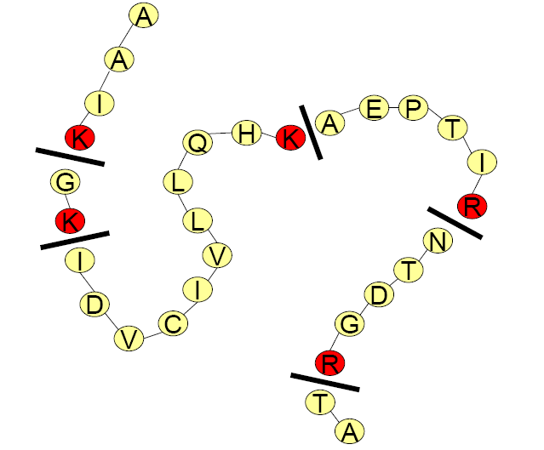
Trypsin – a protease that cleaves after basic residues (R or K).
Protein of Interest:
Trypsin
Trypsin
Notes:
91

Slide 92
Peptide Mass Fingerprinting
MS

Slide 93
Peptide Mass Fingerprint steps
Purify sample
Digest sample, usually trypsin
Determine masses of the peptides
Searching database
Calculate and rank correlation order of proteins in the database

Slide 94
Peptide Mass Fingerprint
Peptide mass fingerprinting
(MALDI-TOF)
Digestion
Matching
& Scoring
Digestion
Database theoretical digestion

Slide 95
B-5-2 Peptide Sequence tags
Digestion
Peptide Mass
Sequence-specific MS/MS
GHVASTYK
Database identification

Slide 96
Peptide sequence tag
A piece of information about a peptide obtained by tandem mass spectrometry that can be used to identify this peptide in a protein database
Developed by Matthias Wilm and Matthias Mann in the mid 90’s
Compose of part AA sequence of a fragment, its N-terminal fragment Mass and its C-terminal fragment Mass

Slide 97
Tandem Mass Spectrometry

Slide 98
B-5-3 de novo protein sequencing
Complete by tandem MS
a_{n}
b_{n}
c_{n}
H+
O
O
O
NH₂-CH C NH CH-C-NH-CH-C-OH
R₁
R₂
R₃
x_{n}
y_{n}
z_{n}

Slide 99
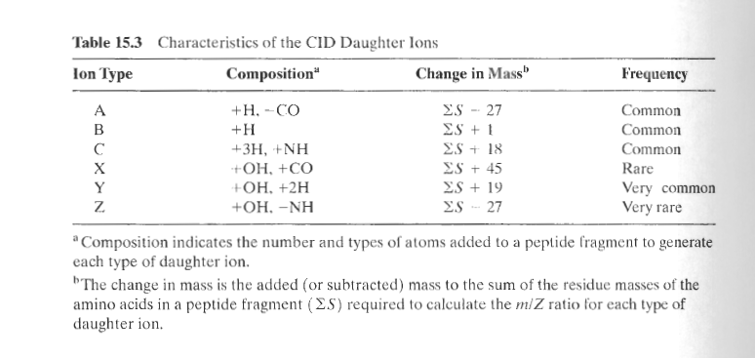
ΣS: the sum of the residue mass of the
amino acids in a peptide fragment

Slide 100
Peptide Fragmentation
Collision Induced Dissociation
H⁺
H...-HN-CH-CO . . . NH-CH-CO-NH-CH-CO-…OH
R_{i-1}
R_{i}
R_{i+1}
Prefix Fragment
Suffix Fragment
Peptides tend to fragment along the backbone.
Fragments can also loose neutral chemical groups like NH₃ and H₂O.

Slide 101
Peptide Fragmentation
b₂-H₂O
b₃- NH₃
a₂
b₂
a₃
b₃
HO NH₃⁺
| |
R₁ O R₂ O R₃ O R₄
| || | || | || |
H -- N --- C --- C --- N --- C --- C --- N --- C --- C --- N --- C -- COOH
| | | | | | |
H H H H H H H
y₃
y₂
y₁
y₃ -H₂O
y₂ - NH₃

Slide 102
Impart energy in collision cell
G
P
F
N
A
G
P
F
N
A
G
P
F
N
A
G
P
F
N
A
G
P
F
N
A

Slide 103
G
P
F
N
A
A
G
P
F
N
G
P
F
N
A
C-terminal peptides
N-terminal peptides
G
P
F
N
A
G
P
F
N
A

Slide 104
Terminal peptides and ion types
Peptide
G
P
F
N
H2O
Mass (D) 57 + 97 + 147 + 114 = 415
Peptide
G
P
F
N
without
H2O
Mass (D) 57 + 97 + 147 + 114 – 18 = 397

Slide 105
N- and C-terminal Peptides
486
G
P
F
N
A
A
G
P
F
N
71
415
301
G
P
F
N
A
185
C-terminal peptides
N-terminal peptides
154
G
P
F
N
A
332
G
P
F
N
A
57
429

Slide 106
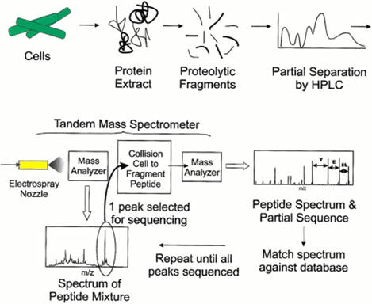
Tandem Mass-Spectrometry

Slide 107
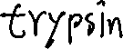
Breaking Proteins into Peptides
GTDIMR
HPLC
PAKID
To
MS/MS
MPSERGTDIMRPAKID......
MPSER
……
……
protein
peptides

Slide 108
Tandem Mass Spectrometry
LC
MS
Scan 1707
collision
cell
MS-1
MS-2
MS/MS
Ion
Source
Scan 1708

Slide 109
Protein Identification by Tandem Mass Spectrometry
S
e
q
u
e
n
c
e
MS/MS instrument
Database search
Sequest
de Novo interpretation
Sherenga

Slide 110
De Novo vs. Database Search
Database Search
De Novo
Mass, Score
W
Database of known peptides MDERHILNM, KLQWVCSDL, PTYWASDL, ENQIKRSACVM, TLACHGGEM, NGALPQWRT, HLLERTKMNVV, GGPASSDA, GGLITGMQSD, MQPLMNWE, ALKIIMNVRT, AVGELTK, HEWAILF, GHNLWAMNAC, GVFGSVLRA, EKLNKAATYIN..
W
Database of known peptides MDERHILNM, KLQWVCSDL, PTYWASDL, ENQIKRSACVM, TLACHGGEM, NGALPQWRT, HLLERTKMNVV, GGPASSDA, GGLITGMQSD, MQPLMNWE, ALKIIMNVRT, AVGELTK, HEWAILF, GHNLWAMNAC, GVFGSVLRA, EKLNKAATYIN..
Database of all peptides = 20^{n} AAAAAAAA,AAAAAAAC,AAAAAAAD,AAAAAAAE,AAAAAAAG,AAAAAAAF,AAAAAAAH,AAAAAAI,
AVGELTI, AVGELTK , AVGELTL, AVGELTM,
YYYYYYYS,YYYYYYYT,YYYYYYYV,YYYYYYYY
R
R
V
A
V
A
L
L
T
G
T
G
E
E
P
L
P
L
K
C
K
C
W
W
D
D
T
T
AVGELTK

Slide 111
De novo Peptide Sequencing
Sequence

Slide 112
How to reconstruct peptide from
the set of masses of fragment ions
(mass-spectrum)

Slide 113
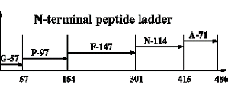
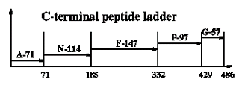
Theoretical Spectrum

Slide 114
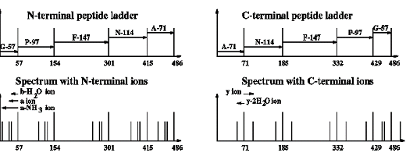
Theoretical Spectrum (cont’d)

Slide 115
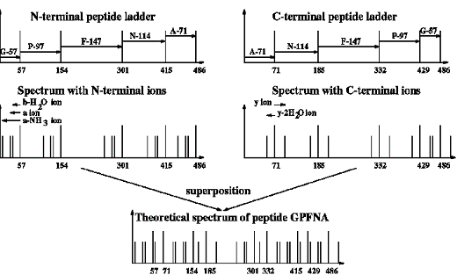
Theoretical Spectrum (cont’d)

Slide 116
Mass Spectra
G
V
D
D
H₂O
L
K
K
L
D
V
G
57 Da = ‘G’
99 Da = ‘V’
mass
0
and Suffix Fragments.
The peaks in the mass spectrum:
Prefix
Fragments with neutral losses (-H₂O, -NH₃)
Noise and missing peaks.

Slide 117
Protein Identification with MS/MS
G
V
D
L
K
Peptide Identification:
MS/MS
Intensity
mass
mass
0
0
If we know the amino acid sequence of a peptide, we can guess what the spectra should look like!

Slide 118
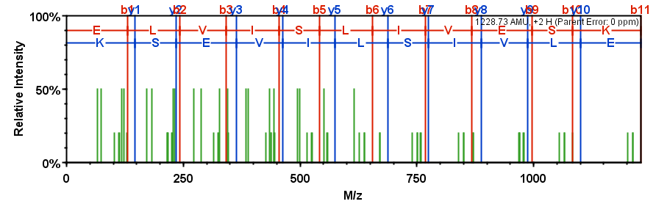
Model Spectrum
Let’s create a hypothetical spectrum
of an example peptide
ELVISLIVESK
Notes:
So as an example, consider the peptide ELVIS LIVES K that was synthesized by Rich Johnson in Seattle

Slide 119
Identify different ions
---Where B and Y ions are estimated at 100%, plus 2 ions are estimated at 50%, and A ions and other stragglers are at 20%.
B/Y type ions (100%)
B/Y +2H type ions
(50%)
A type ions
B/Y -NH₃/-H₂O
(20%)
Notes:
Where B and Y ions are estimated at 100%, plus 2 ions are estimated at 50%, and A ions and other stragglers are at 20%.

Slide 120
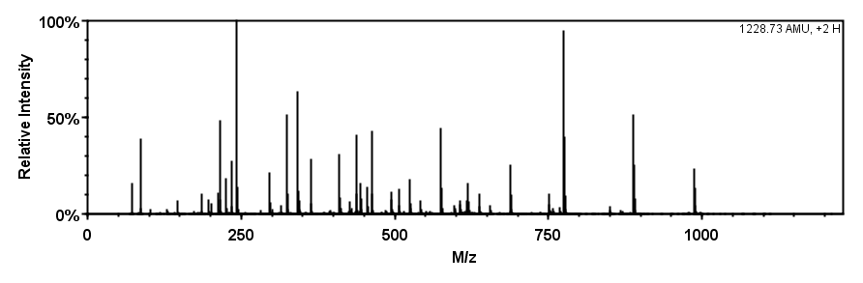
Identify different ions
Notes:
So if we consider the spectrum that was derived from the ELVIS LIVES K peptide…

Slide 121
Identify different ions
Notes:
We can find where the overlap is between the hypothetical and the actual spectra…

Slide 122
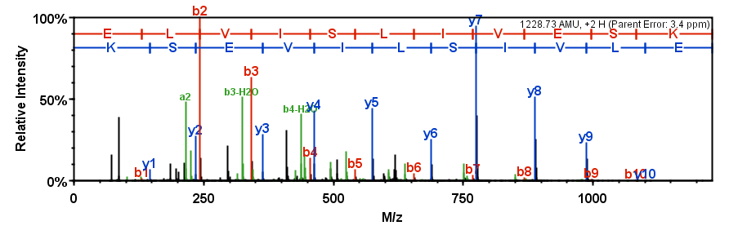
Identify different ions
Notes:
And say conclusively based on the evidence that the spectrum does belong to the ELVIS LIVES K peptide.

Slide 123
Some Mass Differences between Peaks Correspond to Amino Acids
u
q
e
s
e
u
q
e
n
c
n
e
e
s
e
q
c
n
e
u
e
s
c
e

Slide 124
MW of different AAs
 | Amino-Acid | Residual MW |  | Amino-Acid | Residual MW
A | Alanine | 71.03712 | M | Methionine | 131.04049
C | Cysteine | 103.00919 | N | Asparagine | 114.04293
D | Aspartic acid | 115.02695 | P | Proline | 97.05277
E | Glutamic acid | 129.04260 | Q | Glutamine | 128.05858
F | Phenylalanine | 147.06842 | R | Arginine | 156.10112
G | Glycine | 57.02147 | S | Serine | 87.03203
H | Histidine | 137.05891 | T | Threonine | 101.04768
I | Isoleucine | 113.08407 | V | Valine | 99.06842
K | Lysine | 128.09497 | W | Tryptophan | 186.07932
L | Leucine | 113.08407 | Y | Tyrosine | 163.06333

Slide 125
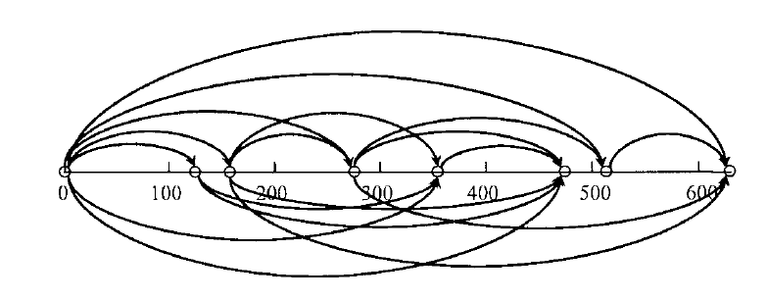
A
E
P
T
A
E
P
Intensity
A
E
A
399.2
298.1
201.1
ELVISLIVESK
72.0
M/z

Slide 126
Ladder Sequencing
A sequencing method combining terminal degradation with mass spectrometry
Principles：
N-terminal commonly uses chemical digestion, C-terminal commonly uses protease digestion,
generates a series of C-or N-terminal converted fragments (1 AA of each step of the peptide sequence)
ladder molecular weight was analyzed by mass spectrometry
the type of AA was determined by the difference of molecular weight
ladder sequence was determined.
MS：FAB，PD(plasma desorption), ESI, MALDI-TOF
Advantages：High data acquisition rate, short determination time, less sample requirement, high sensitivity (picomole to femtomole)

Slide 127
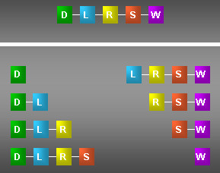
Ladder 示意图

Slide 128
Things To Remember
Gly + Gly = 114.043 u and Asn = 114.043 u
Ala + Gly = 128.059 u and Gln = 128.059 u and Lys = 128.095 u
Gly + Val = 156.090 u and Arg = 156.101 u
Ala + Asp = Glu + Gly = 186.064 and Trp = 186.079 u
Ser + Val = 186.100 u and Trp = 186.079 u
Leu = Ile = 113.084u
Increase the difficulty of MS-based sequencing

Slide 129
B-6 Use MS/MS to reveal structure
Peptide sequence
Post translational modifications
Proteolytic processing, truncation
Trypsin, Endoproteinase mapping
Acylation
Missing of N-terminal peptide
Phosphorylation
Differential mapping /phosphatase treatment
Fe ³⁺ -loaded IMAC column
Glycosylation
Neuraminidase treatment

Slide 130
ESI and Protein conformation
ESI spectra are actually quite sensitive to the conformation of the protein
Folded, ligated or complexed proteins tend to display non-gaussian peak distributions, with few observable peaks weighted toward higher m/z values
Denatured or open form proteins/peptides which ionize easier tend to display many peaks with a classic gaussian distribution

Slide 131

ESI and Protein Conformation
Native Azurin
Denatured Azurin

Slide 132

MALDI-MS spectrum
A: peptide bound to IMAC beads applied directly to MALDI
B:MALDI-MS/MS (Q-TOF) to locate phosphorylation site
contains phosphorylated residue

Slide 133


Slide 134
Questions
Which protein characteristics (IDs) can be used to search databases to identify proteins? How do I get these protein IDs?
What are the techniques of microsequencing?
What is mass spectrometry? What are the components of the mass spectrometer and what are their representatives?
Compare: 1) ESI-MS vs MALDI-MS 2) MS/MS sequencing vs Ladder sequencing
What is tandem mass spectrometry? How is it classified? How does it differ from conventional mass spectrometry in structure and application?
How to Use Biomass Spectrometry to Study Proteome
What are the MS-based sequencing techniques ? The Principle? The Samility and difference
What is the peptide mass fingerprint (PMS)? What is a peptide sequence tag? How to get them?

Slide 135
Computer Exercises
Search a ESI data of a protein and use it to calculate the MW of the protein
Whole protein analysis
Explore Expasy information available for a protein
Find the theoretical MW of a protein
Find the amino acid sequence of a protein in FASTA format
Explore the X-ray crystal structure of a protein
Peptide Mass Mapping
Identify a protein from a peptide mass list
Confirm this identity by producing a theoretical mass list
Optional (for the speedy ones) identify more unknowns from
mass lists
Peptide Sequencing & Protein ID
Identify a peptide (and it’s protein) from an MS-MS mass list
Find an unknown protein
Use the Information provided below to find an unknown peptide
MS spectrum
MS/MS spectrum

